Slide 1
Parallel Imaging Reconstruction Using Automatic Regularization
: Implementation
Jaeeun Lee
2018/09/07

Slide 2
Contents
Implementation
Python
L-curve

Slide 3
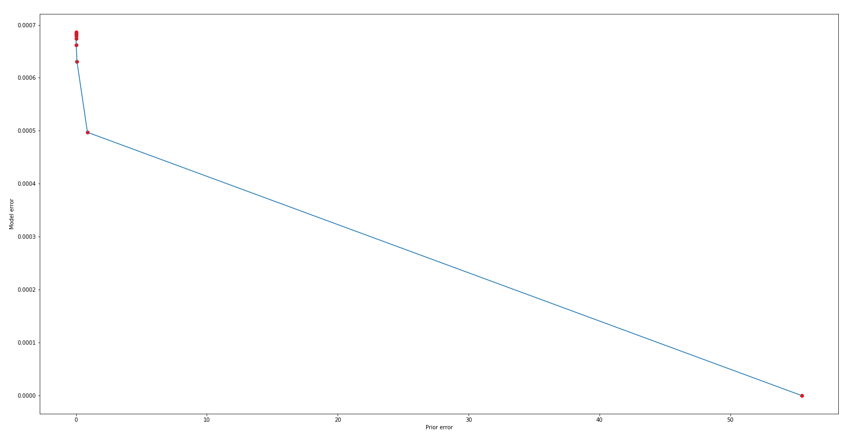
n_cov_inv = np.linalg.inv(n_cov)
ncov_w,ncov_v = np.linalg.eig(n_cov_inv)
Lambda = 0, 0.01, 0.02, …., 0.09
Lmbd = 0.1
Lmbd = 0

Slide 4
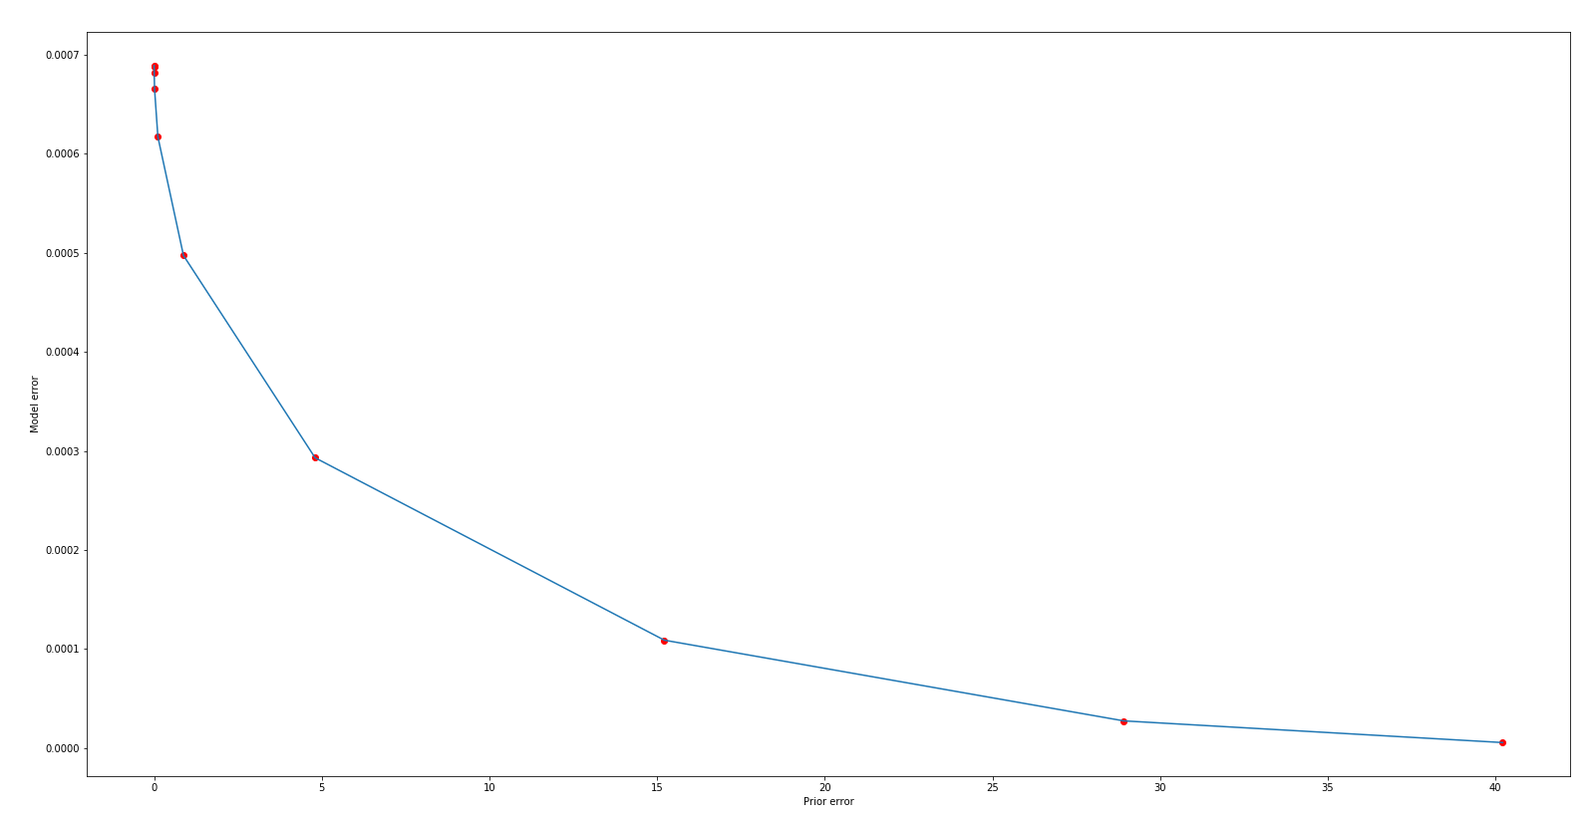
n_cov_inv = np.linalg.inv(n_cov)
ncov_w,ncov_v = np.linalg.eig(n_cov_inv)
Lambda = 10**(-3+0.25*lmbd_idx), lmbd_idx = 0~9
Lmbd = 0.178
Lmbd = 0.0056
Lmbd = 0.001

Slide 5
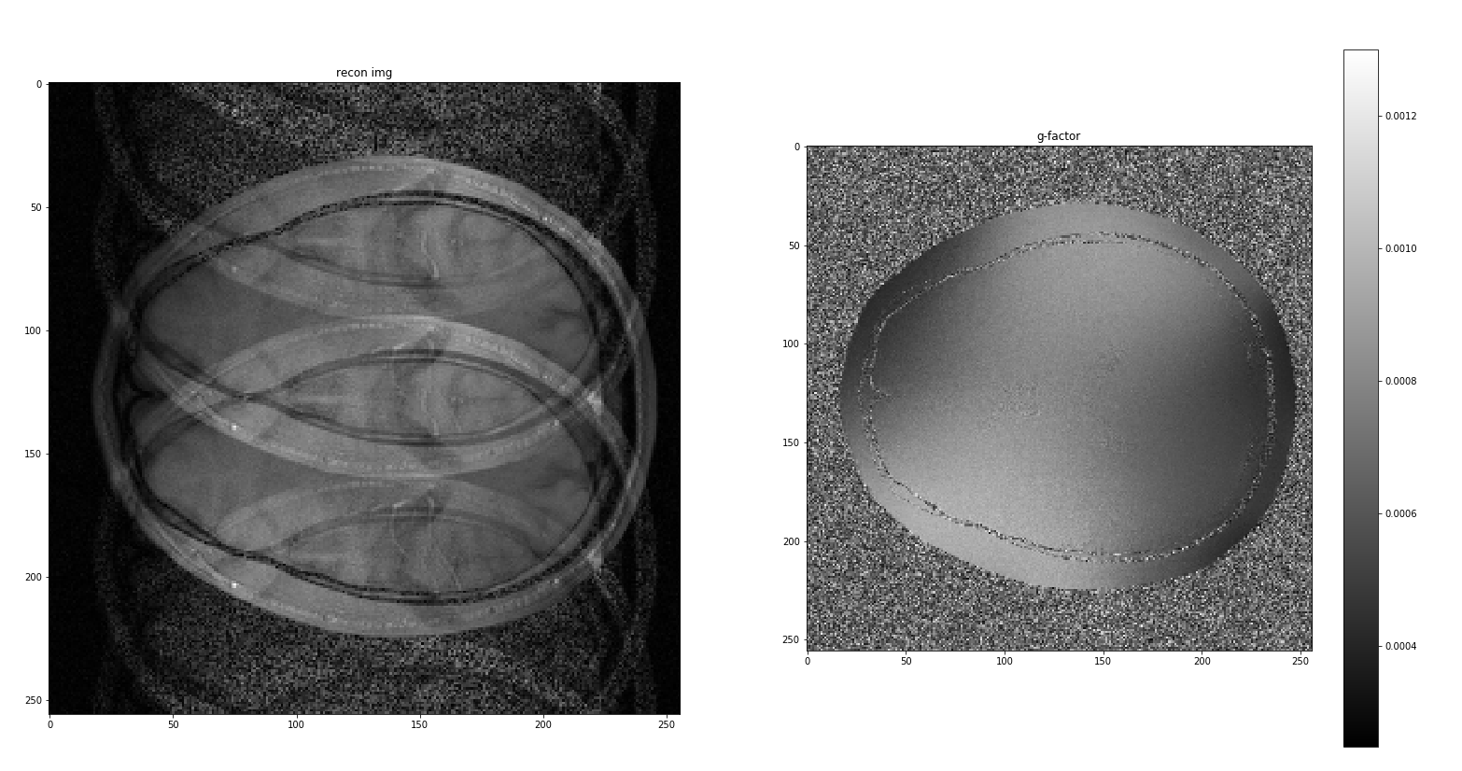
Lmbd = 0.1
n_cov_inv = np.linalg.inv(n_cov)
ncov_w,ncov_v = np.linalg.eig(n_cov_inv)

Slide 6
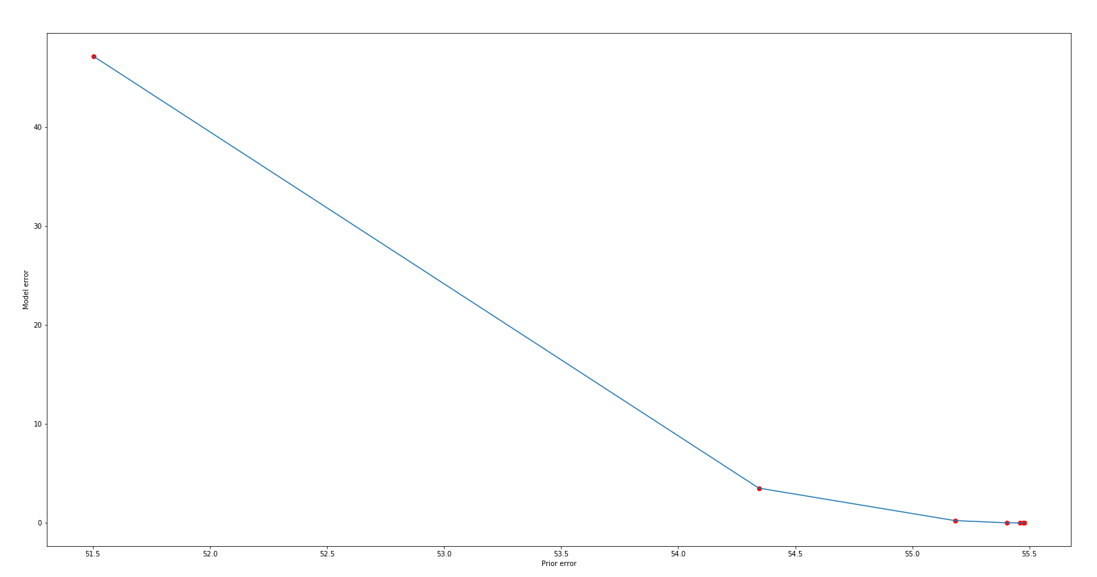
ncov_w,ncov_v = np.linalg.eig(n_cov) # cov_inv = v @ np.diag(w) @ np.matrix.getH(v) // diagonalisation
Lambda = 10**(-2+0.3*lmbd_idx), lmbd_idx = 0~9
Lmbd = 5.012
Lmbd = 2.512
Lmbd = 0.01

Slide 7
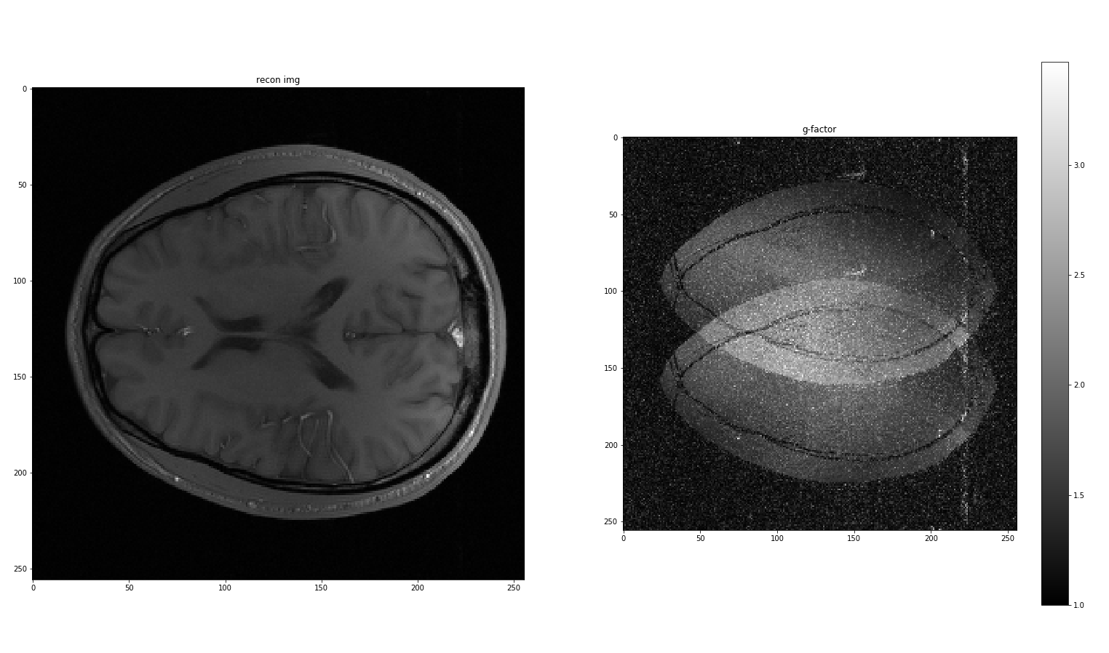

ncov_w,ncov_v = np.linalg.eig(n_cov) # cov_inv = v @ np.diag(w) @ np.matrix.getH(v) // diagonalisation
Lmbd = 2.512

Slide 8
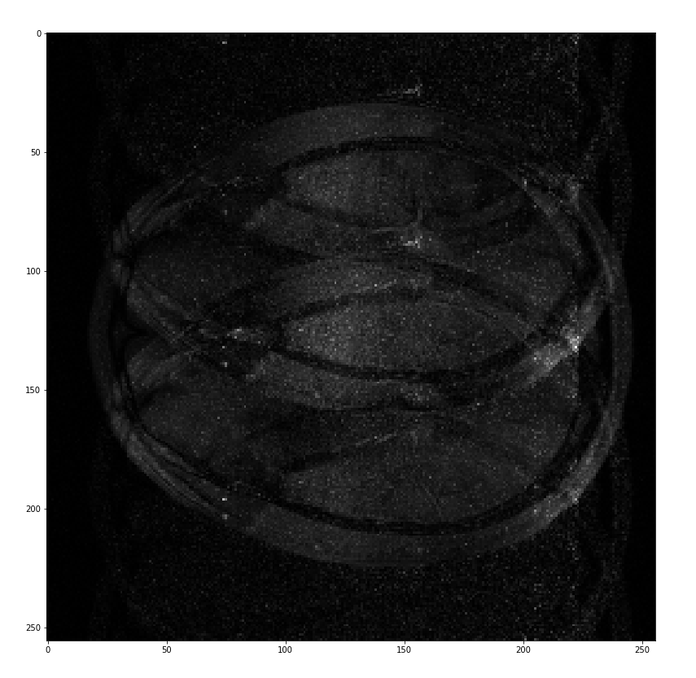
ncov_w,ncov_v = np.linalg.eig(n_cov) # cov_inv = v @ np.diag(w) @ np.matrix.getH(v) // diagonalisation
Lmbd = 2.512

Slide 9
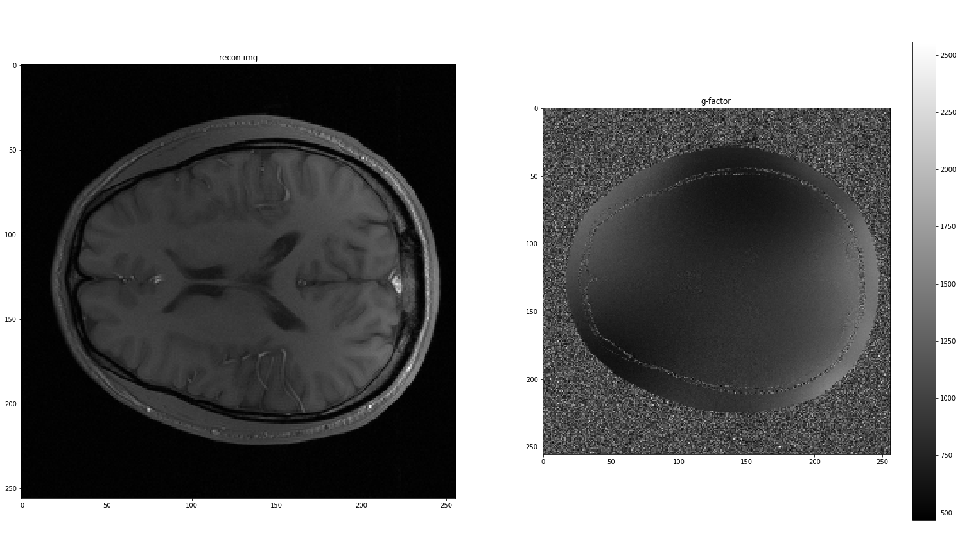
ncov_w,ncov_v = np.linalg.eig(n_cov) # cov_inv = v @ np.diag(w) @ np.matrix.getH(v) // diagonalisation
Lmbd = 2.512
-1

